Slide 1


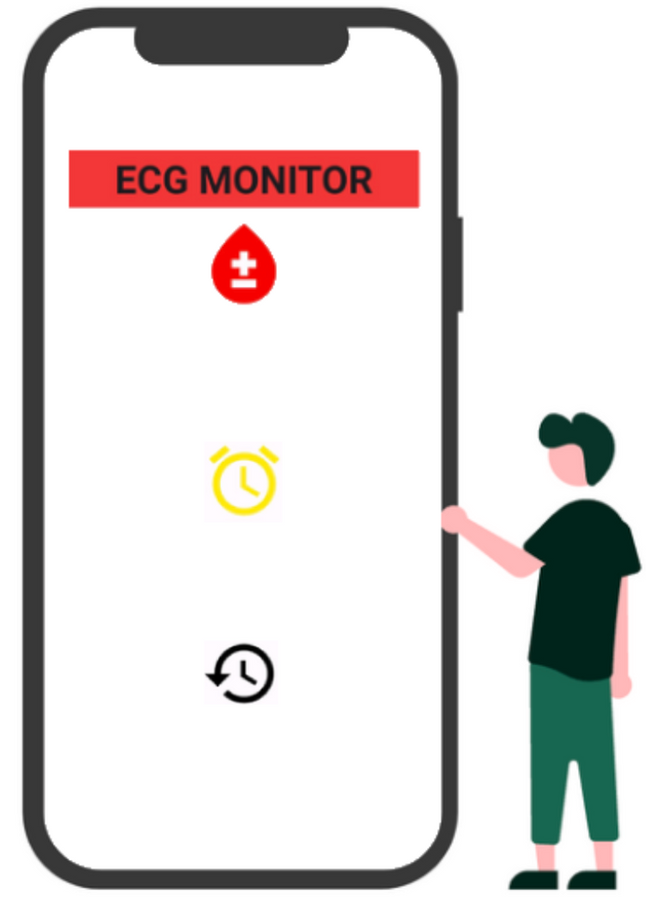
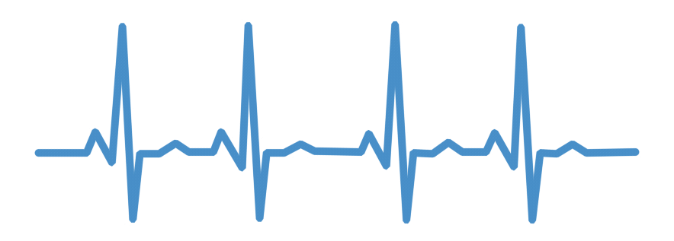
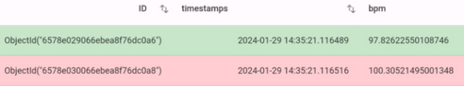
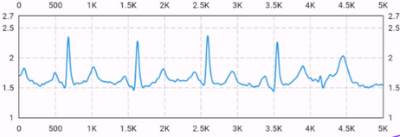

IOT BASED ECG
MONITOR
Kuiyu DING - 62716
Fahadh Mohamed JAHEER HUSSAN - 62720
Nuhu BELLO - 62713
Muhammad Arshad Shamshudeen AHMED - 62708

Slide 2
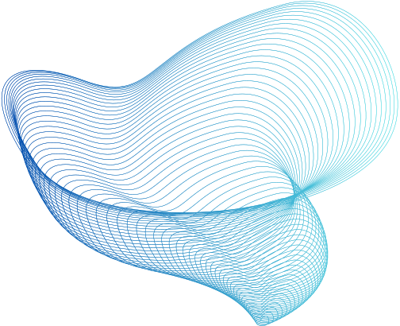

TABLE OF CONTENT
1.Introduction
2.ECG sensor integration
3.Data processing
4.Data storage
5.Mobile application -- Flutter
Context , Architecture
AD8232 ECG Sensor
Connect sensor to Arduino
MQTT
BUFFER
R-PEAK DETECTION--Neurokit2
MongoDB Atlas
PHYSIONET
Live ECG data
Alarm
Historical data

Slide 3
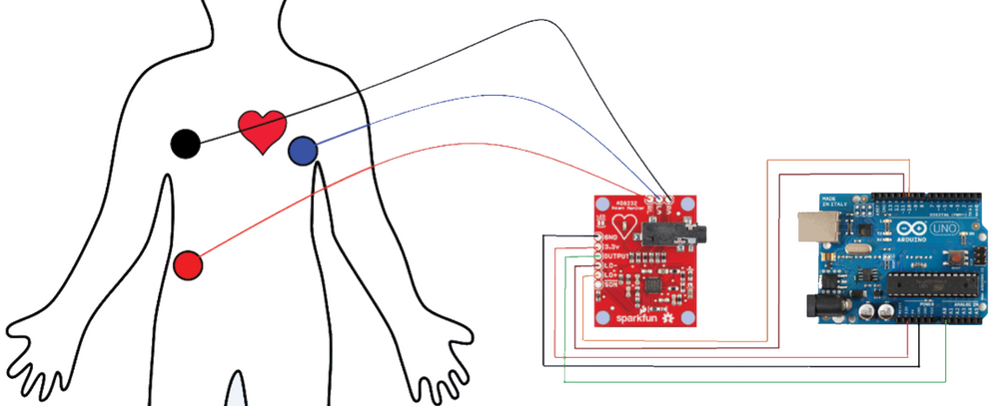




INTRODUCTION
In the IoT world, healthcare and technology combine to enable real-time health monitoring, and all data can be used for health tracking, early detection of cardiac abnormalities, and more.
Back end
Front end
Working flow:
Using Arduino-ECG sensor pairing and MQTT for efficient data flow
live ECG data
Alarm
Storage data
Cloud-based database stored historical ECG data
Using a specialized R peak detection algorithm to gain accurate bpm value

Slide 4

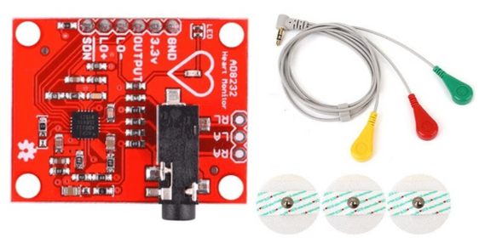
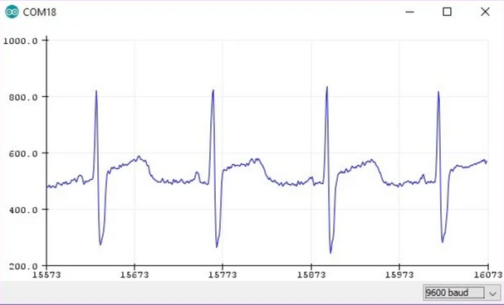
ECG sensor integration
AD8232 ECG Sensor and Arduino
The AD8232 is an integrated signal conditioning block for ECG it acts as an operational amplifier to extract clear signal during PR and QT interval of the heartbeat.
Place ECG Sensor on Body and link to arduino.
value on serial monitor and the image on serial plotter
The closer to the heart the pads are, the better the measurement

Slide 5
DATA PROCESSING

Slide 6
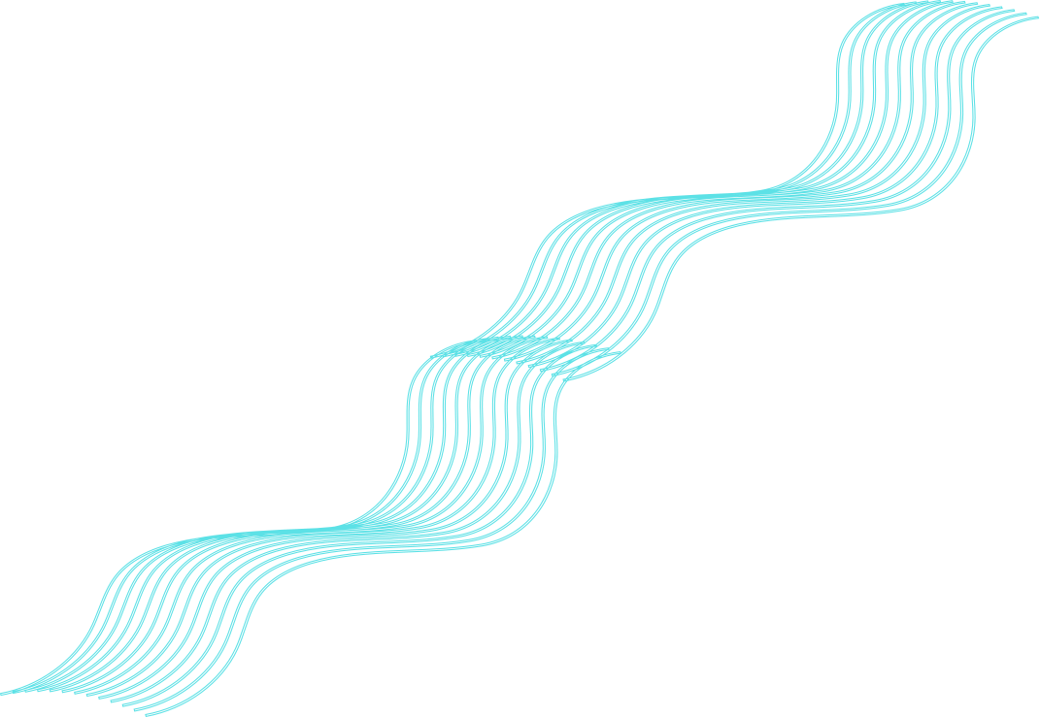
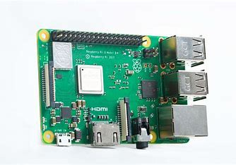

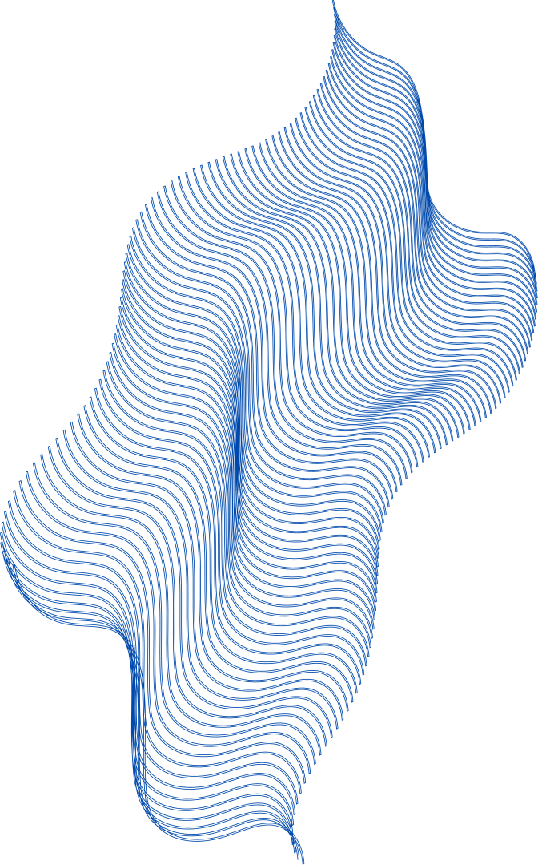
MQTT
MQTT, which stands for MQ Telemetry Transport, is a lightweight messaging protocol for the Internet of Things (IoT) and machine-to-machine communication.
MQTT uses a publish/subscribe model, the Arduino publishes ECG data to a topic, which is then transmitted to a central broker. The Raspberry Pi subscribes to this topic, enabling it to receive and process the ECG data from the Arduino.
Mosquitto Broker

Slide 7
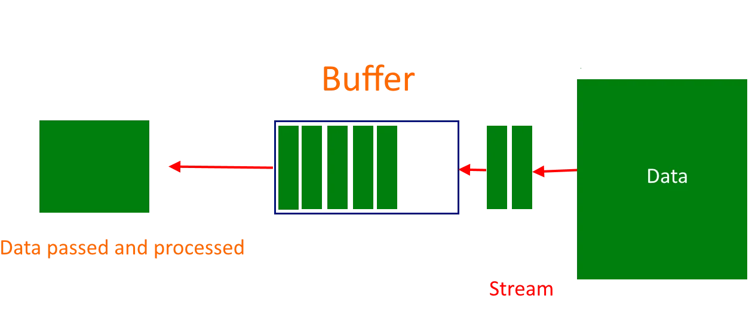
BUFFER
After getting the data from MQTT protocol, The buffer is a Python list used to store a 500 ECG samples. As new ECG data is received, it is appended to the buffer, and when the buffer reaches its maximum length, processing is triggered.

Slide 8

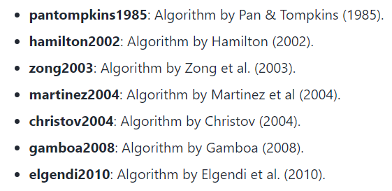
NeuroKit2 is a Python library designed for physiological signal processing and analysis, including electrocardiography (ECG), electrodermal activity (EDA), and electromyography (EMG). The ECG data is sampled at a rate of 22Hz.
NEUROKIT2
ecg_peaks function from NeuroKit2 is utilized to detect R-peaks in the ECG signal (method = "pantompkins1985")
ecg_rate function from NeuroKit2 is used to calculate heart rate (BPM)

Slide 9
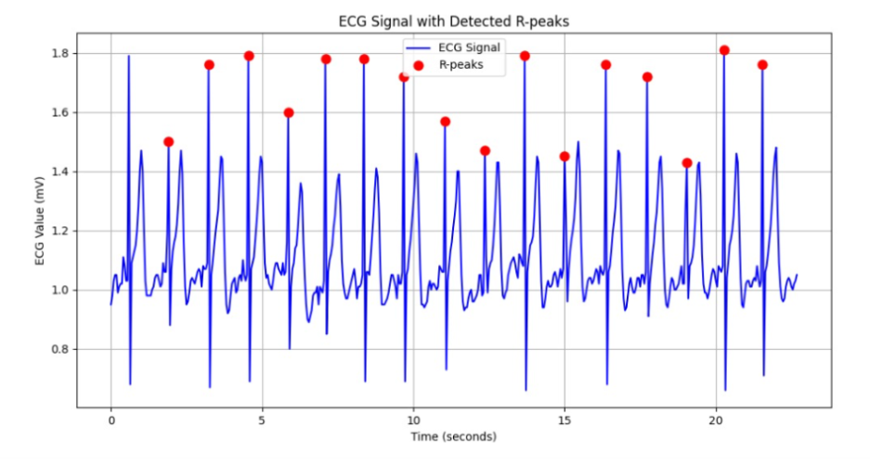
R-PEAK DETECTION

Slide 10
DATA STORAGE

Slide 11
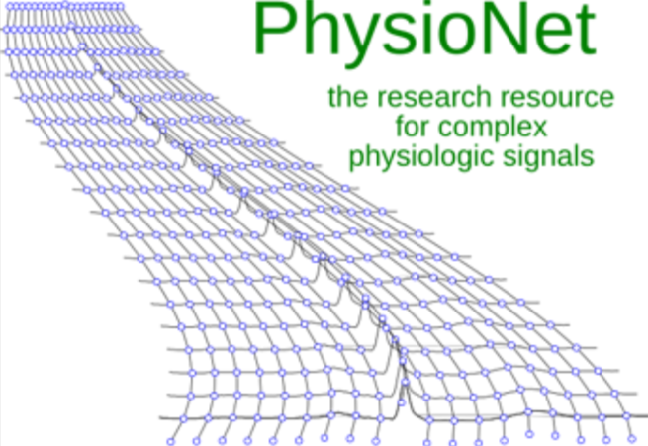
PHYSIONET
- Used PhysioNet for ECG Signal Data
- Employed wfdb Library on Raspberry Pi for Data Retrieval
- Created 5000-sample Buffer for ECG Signal Storage
- Used NeuroKit Library to Detect R-peaks
- Calculated Heart Rate (bpm) from Identified R-peaks

Slide 12
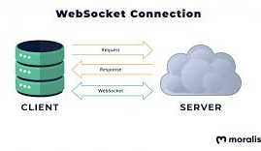
WEBSOCKET
Communication Protocol for Real-time Bidirectional Data Exchange
- Persistent Connection for Continuous Message Transmission
- Efficient and Low-latency Communication
- Commonly Used in Web Applications for Real-time Features
- Applications include Chat, Live Notifications, and Interactive Gaming
- Facilitates Transmission of Processed Data to MongoDB Atlas Database

Slide 13

MONGODB
- Flexibility and Scalability
- JSON-like Document Storage
- Designed for Large Data Volumes
- Index Support and Replication
- Horizontal Scaling through Sharding
- Versatility in Applications
- Language and Platform Support

Slide 14
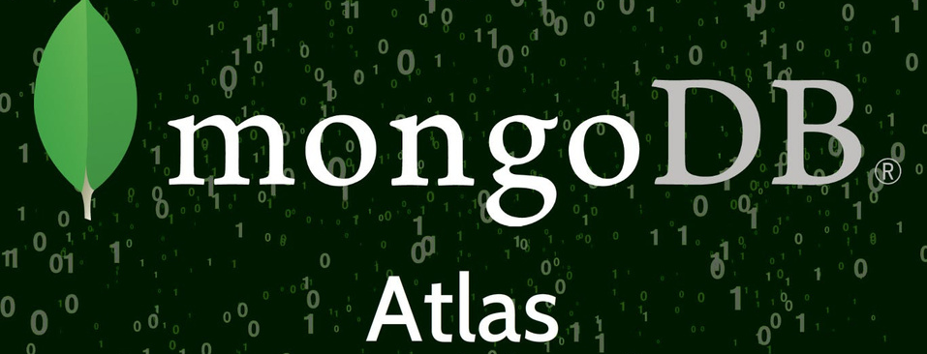
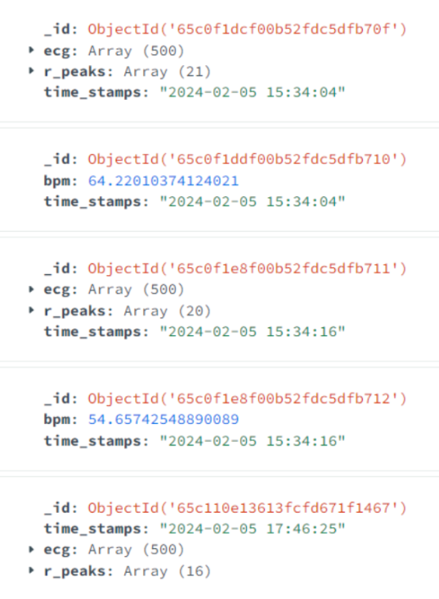
MONGODB ATLAS
MongoDB Atlas simplifies database management in the cloud with automated scaling, security measures, and monitoring. In our project, 500 ECG samples, along with R-peaks and BPM, are sent to MongoDB Atlas using the connection string and viewed in mongodb compass

Slide 15
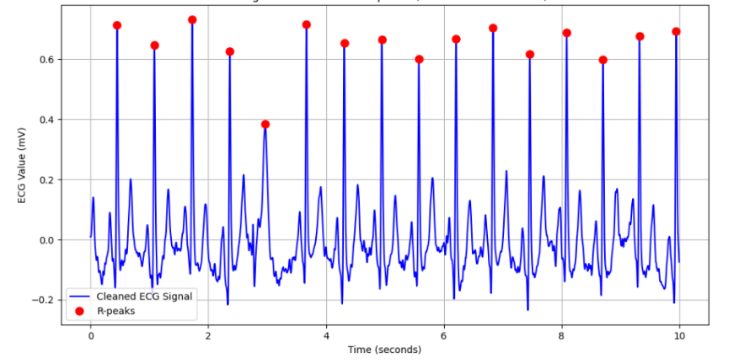
R-PEAK

Slide 16
MOBILE APPLICATION

Slide 17

FLUTTER
Flutter is an open-source UI software development toolkit created by Google, designed for building natively compiled applications for mobile, web, and desktop from a single codebase

Slide 18

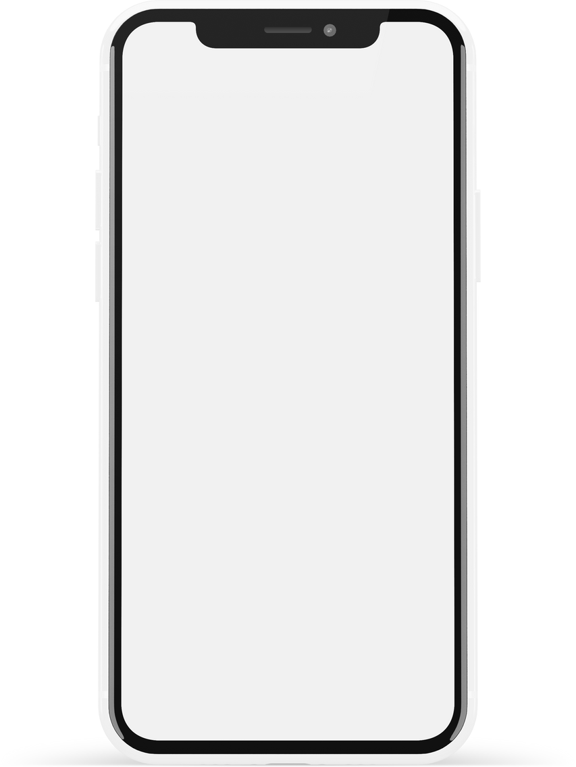
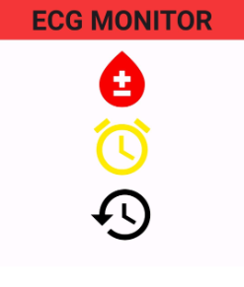
Mobile Application
We have developed a mobile application using Flutter to visualize and interact with the ECG data.
ECG
The Mobile Application consists of Three main parts:
Live ECG Data
Alarm
History

Slide 19
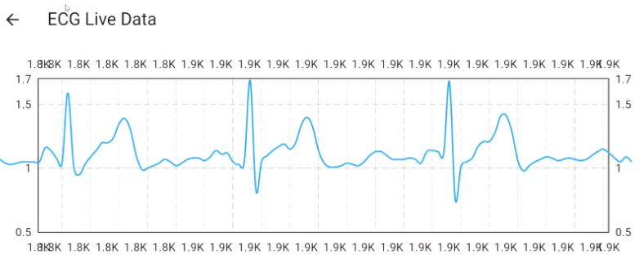
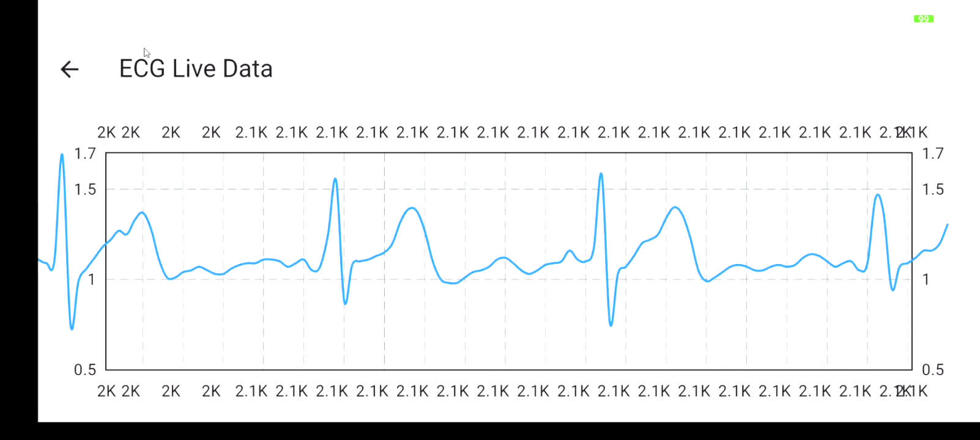
LIVE ECG DATA
The Flutter application receives and processes this real-time data through the MQTT client

Slide 20
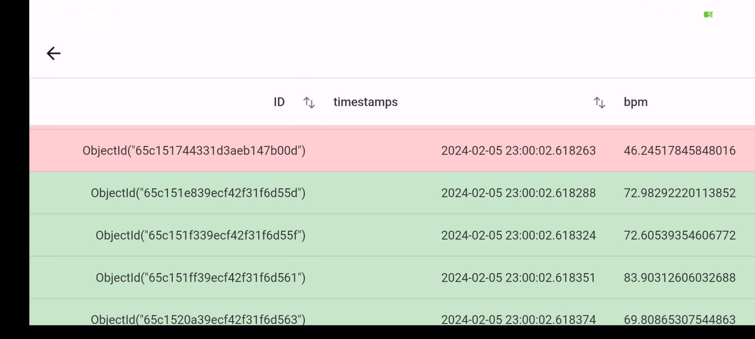
ALARM
The BPM data stored in the database are visually alerts users if the BPM falls below 60 or exceeds 100. This visual indication uses colours, showing red for abnormal BPM values and green for normal ones.

Slide 21
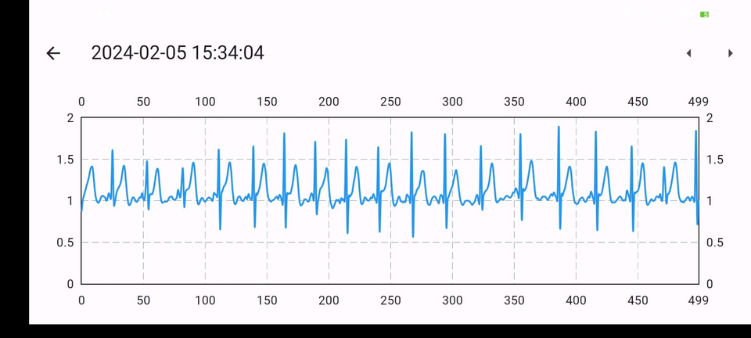
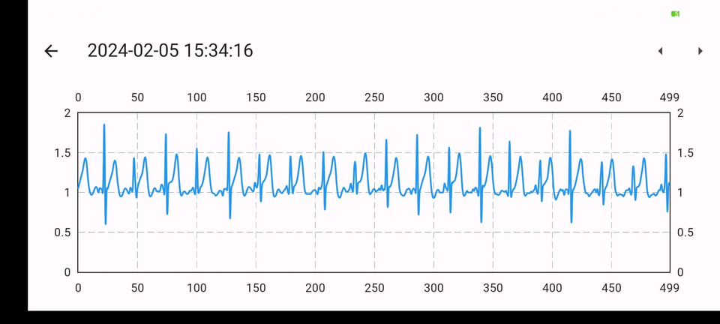
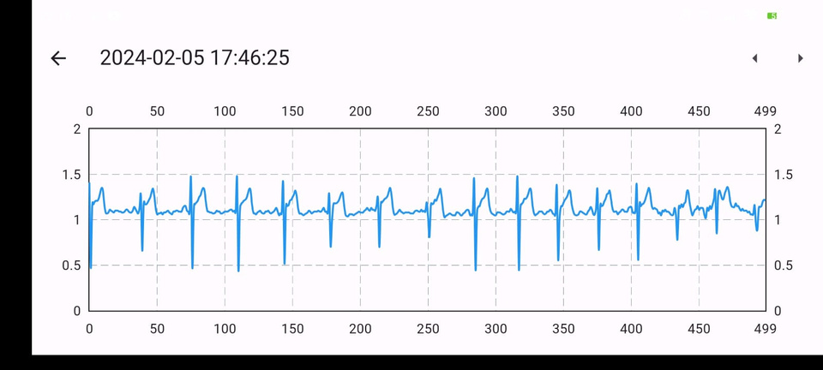
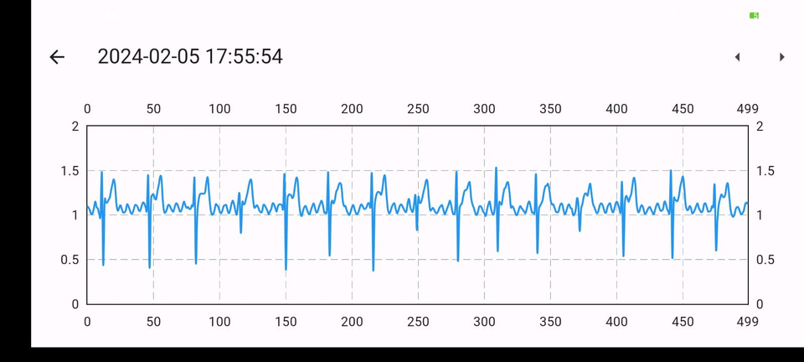
HISTORY
The Storage part of the application retrieves stored ECG samples from MongoDB Atlas using the MongoDB connection string. It allows users to view the ECG signal in graphical form, presenting images of the signal for the last 500 samples stored in the buffer.

Slide 22
CONCLUSION
In summary, the project successfully integrates hardware, communication protocols, data processing algorithms, and cloud-based storage for a comprehensive ECG monitoring system. It holds potential applications in preventive healthcare and personalized fitness tracking.
Moving forward, the project could enhance signal processing with machine learning, broaden compatibility with different ECG devices, and improve the user interface.

Slide 23
CHALLENGES
Detection of R Peak: Ensuring accurate detection of R peaks in ECG signals, especially in the presence of noise.
Calculation of BPM: Accurately calculating heart rate (BPM) from the detected R peaks while considering variable signal quality.
Live Data Display in Flutter Application: Achieving real-time data visualization in a Flutter application for a seamless user experience.
Sensor Issues: Addressing potential issues with the ECG sensor, such as signal artifacts or connectivity problems.

Slide 24
THANK YOU

